Slide 1



Studypilot

Slide 2
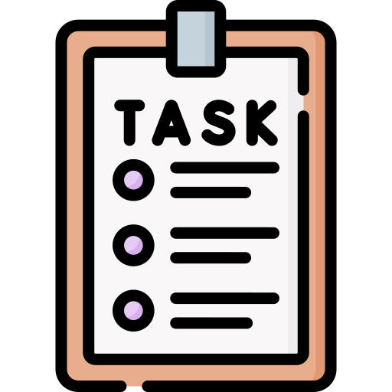
OUR TASK
Our task was to create an application that would provide the best internship opportunities for The high school students. To do this, we used Service Design’s technology and k – nearest neighbours to provide the best opportunity for a given student.

Slide 3
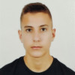
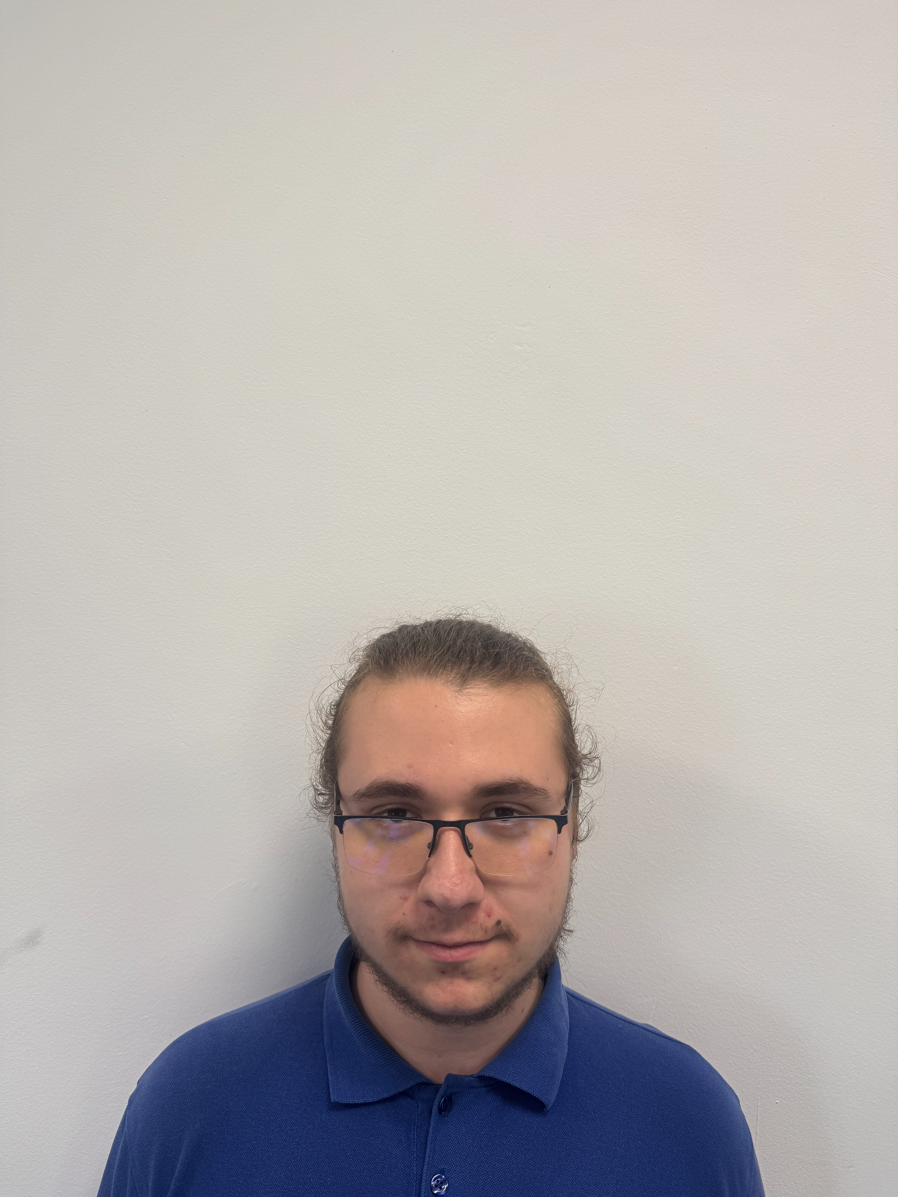
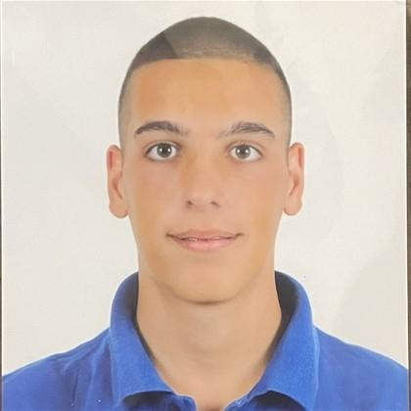

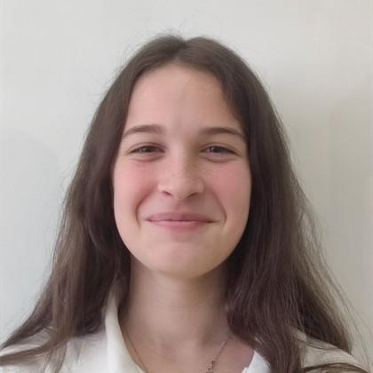
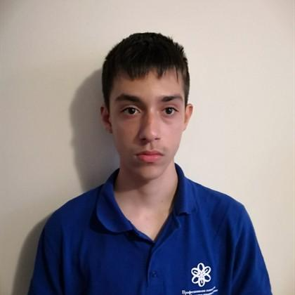
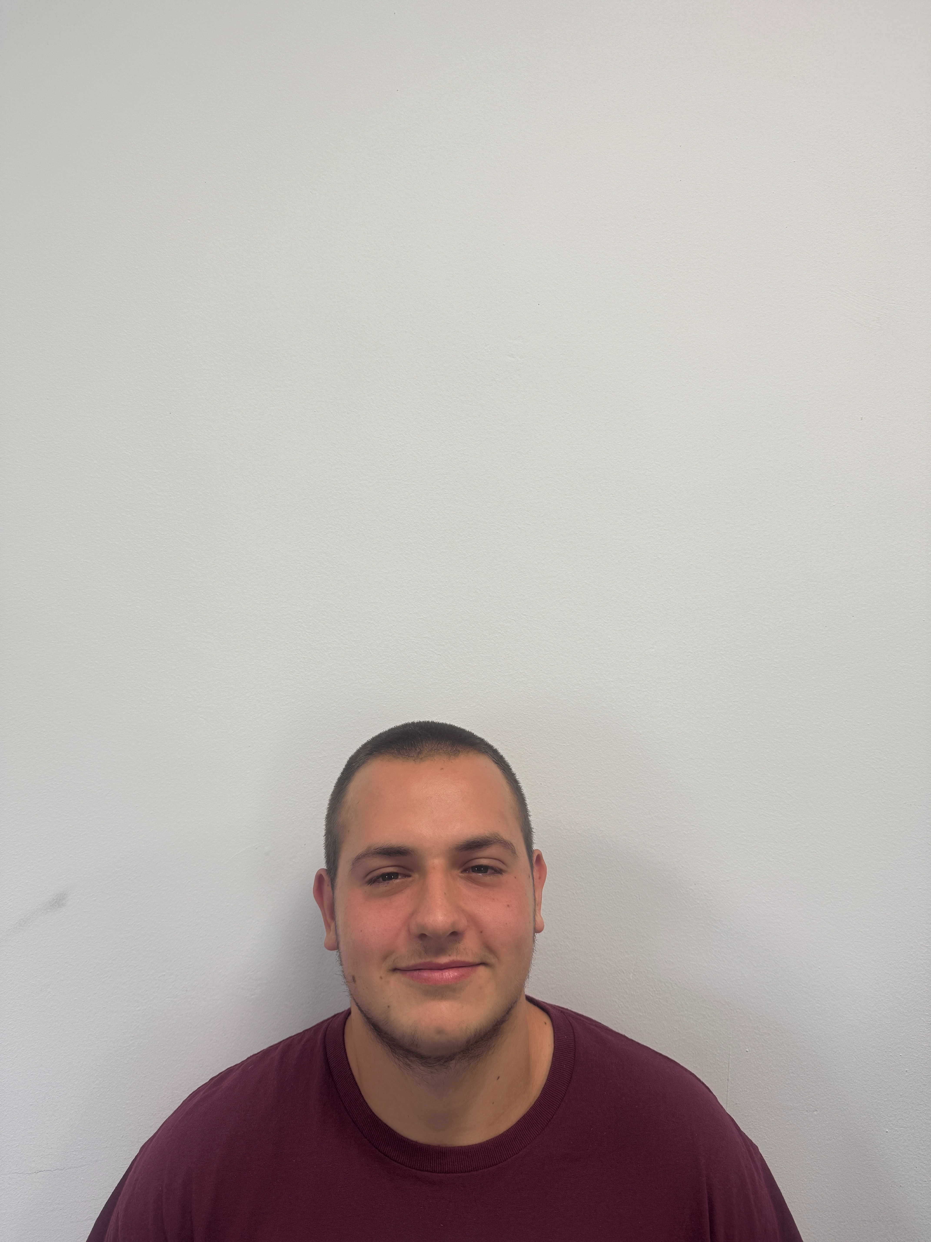
OUR TEAM
Project manager
Project manager
Back-end developer
Back-end developer
Designer
Designer

Slide 4
STAGES OF REALIZATION
01
02
03
04
We formed our team and outlined the core features of the application.
Roles were assigned, and tasks were distributed based on our strengths.
We began developing and testing the app in iterative cycles.
Finally, we prepared the documentation and presented the completed project.

Slide 5










USED TECHNOLOGIES

Slide 6

NOW LET’S MOVE TO THE app!

